Slide 1
Principles of Concurrent
Systems - Threads
Process Decomposition and Granularity
Threads: The CThread class
Active Objects
Note: Examples of the concepts presented here can be found in the RTExamples folder: Q2
You are encouraged to open the project(s) in Visual Studio and run the program(s)
©Paul Davies 2020. Not to be copied, used, or revised without explicit written permission from the copyright owner. This lecture may contain animations and is best viewed as a slide show

Slide 2
System Software Granularity
In the last lecture we saw how it was possible, using the CProcess() class, to design and code a system composed of a number of smaller processes that could be executed in parallel or concurrently instead of one large monolithic single tasking application.
Granularity is a term used in concurrent systems design to describe the degree of parallelism that exists inside a system.
The term ‘granularity’ originates from the idea that any big rock (our monolithic single tasking system) could be broken down into smaller and smaller rocks (starting with process decomposition).
Decomposing a system into a number of relatively large processes, represents what is known as crude or coarse grained granularity. It doesn’t make things necessarily faster, but can help in distributed (networked) systems by allowing processes to run on remote servers.
(See http://en.wikipedia.org/wiki/Granularity#In_computing)

Slide 3
Thread Granularity
In addition to breaking a system down into a number of concurrent processes, we could further break down those processes into a number of parallel executing ‘threads’, each of which represents a traceable path of sequential programming within a process.
In theory we could use threads to decompose our system into finer and finer sections of parallel executing code until we achieve perfect or fine grained granularity where almost everything is run in parallel. We saw last week when we discussed how to calculate the expression B² – 4AC.
However finer granularity leads to more data dependencies
Creating too much parallelism leads to increases in data dependencies reducing the amount of real world parallelism taking place.

Slide 4
Application/Process/Thread Decomposition
Towards Crude, single tasking systems running on 1 CPU/Core
Monolithic
System
Monolithic
System
Worse
No Granularity
System broken down into processes
Multi-tasking systems
Process
Process
Process
Process
Process
Process
System broken down into processes:
Coarse grained or Process Granularity
Processes broken down into smaller processes
Process
Process
Process
Process
Process
Process
Smaller Processes broken down into threads
Multi-threaded systems
Processes broken down into threads: Fine grained or Thread Granularity
Thread
Thread
Thread
Thread
Thread
Thread
Threads broken down into smaller threads
Thread
Thread
Thread
Thread
Thread
Thread
Tending towards highly parallel programming with increasing data dependencies
Better
Towards “Dust”

Slide 5
Fine Granularity: Communication and Synchronisation Problems
As we create systems with more threads, the communication and synchronisation problems in our system tend to grow exponentially because the data processed by the system tends to get scattered amongst smaller and smaller threads creating more data dependencies which in turn leads to synchronisation problems slowing everything down.
This problem is analogous to our attempts to break down a large main() function into many smaller C functions. That restructuring of the code means that data now has to pass back and for between functions as arguments and returned data and creates more of an overhead than the actual computation itself.
Process/Thread
Thread
Process/Thread
Thread
Process/Thread
Thread
Communication Problems
Synchronisation Problems
Process/Thread
Process/Thread
Thread
Thread
Process/Thread
Thread

Slide 6
Problems in Concurrent Systems Design: Race Conditions
Consider the 2-thread program below, where x is a variable shared by threads A and B.
Thread A Thread B
Line A1: x = 5; Line B1: x = 7;
Line A2: print x;
Question: If we ran both threads simultaneously
What value of x gets printed?
What is the final value of x when both tasks have completed?
It depends on the order in which the statements are executed at run time.
One possible execution order is [Lines: A1 -> A2 -> B1], in which case the
printout of the program is 5, but the final value of x = 7.
Puzzle: What execution order yields a printout of 5 and a final value for x = 5?
Puzzle: What execution order yields a printout of 7 and a final value for x = 7?
Puzzle: Is it possible to see a printout of 7 and a final value for x = 5? Are you sure?
Puzzle: Will we always see the same result each time. What factors may influence this?
Questions like these are an important part of designing concurrent systems
What execution orders are possible and what are the effects of that order?
How do we enforce a particular execution order between multiple threads?

Slide 7
Concurrent Processing with Threads
Multi-Threading is useful as it allows a program to carry out several tasks at the same time.
For example ‘Microsoft Word’ has been written to be multi-threaded (in a limited way) so that it is simultaneously able to.
  Respond to your typing.
  Perform Spell and Grammar checking as you type.
  Save or Print your document in the background.
Coding Multi-Threaded Programs
Threads are usually coded as part of the same C/C++ source file within a process, and may even look a little bit like functions.
However it is important to realise that ‘thread functions’ execute in parallel not only with each other but with all other processes/threads running in the system as a whole.

Slide 8
Coding Multi-Threaded Programs (cont…)
Every application/program that you write has at least one thread
All the programs you wrote in APSC 160 and CPSC 259 were single threaded as they had a single point of entry and exit marked by main(). The program started, followed a path dictated by if-else and do-while type decisions in your code which in turn were based on data and conditions that arose at run time. The important point however was that only one CPU instruction in that program was executing at any point in time.
With multi-threading it is possible that several instructions in your program are being executed at the same time (as part of multiple threads)
However, as we saw with processes, once an application is up and running, it can create other (child) threads by making appropriate Kernel calls.
Scheduling of Threads
Thread execution is controlled by the Operating System Kernel using
  Time-slicing (if only a single CPU/Core is available)
  Running them on additional Cores/CPU in a Multi Core/CPU Environment.
  Some combination of both.

Slide 9
Advantages of Multi-Threaded Code
Responsiveness
  A multi-threaded application does not have to wait for one activity to complete before starting another e.g. background printing or spell checking in word.
Better use of Multi-processors/Multi-cores
  Because the allocation of processes and threads to CPUs and cores is handled transparently by the OS Kernel. Making more CPUs/cores available to a multi-threaded application generally results in an automatic improvement in application performance without the need for alterations to the program.

Slide 10
Multiple Threads run more efficiently than Multiple Processes
  Scheduling Multiple threads within the same process is more efficient (i.e. imposes less of an overhead on an operating system) than scheduling multiple processes.
  That is, there is less information to save during a task swap between threads in the same program, compared to threads within different programs, so a multi threaded program is more efficient than a program broken down only into multiple processes.
  Communication between threads in the same program is easier than communication between processes, as information does not need to cross process boundaries, i.e. threads in the same process can communicate through shared global variables.

Slide 11
Creating Threads
using the RT Library
-
The CThread Class

Slide 12
The RT Library creates threads by making direct calls to the Windows Kernel. This requires that any parameters passed to the thread are passed as a single reference (via a pointer). The thread function also has a slightly peculiar signature in Visual C++.
A CThread object is needed to represent and control each thread within your process. The constructor for this class will invoke the necessary Kernel calls to create and schedule a thread to run on the computer.
UINT _ _stdcall ChildThread1( void *args )
{
. . .
}
void main()
{
CThread t1( ChildThread1, ACTIVE, NULL) ;
. . .
t1.WaitForThread() ; // if thread already dead, then proceed, otherwise wait
}
Special Microsoft specific Thread Signature
Pointer to the data passed to thread at creation
Program Child Thread
Name of the function acting as our thread
Thread Status: ACTIVE or SUSPENDED
Pointer to Optional data we can pass to the thread at creation
Program Main Thread
Application/Program Source File with 2 Threads

Slide 13
A More Detailed Example Program using Multiple Threads (See RTExamples: Q2)
#include "rt.h”
UINT _ _stdcall ChildThread1( void *args )
{
for (int i = 0; i < 1000; i ++)
cout << "Hello From Thread 1\n” ;
return 0 ;
}
UINT _ _stdcall ChildThread2( void *args )
{
for (int i = 0; i < 1000; i ++)
cout << "Hello From Thread 2\n” ;;
return 0 ;
}
void main()
{
CThread t1( ChildThread1, ACTIVE, NULL) ; // create two active secondary child threads with no args
CThread t2( ChildThread2, ACTIVE, NULL) ;
t1.WaitForThread() ; // if thread already dead, then proceed, otherwise wait for it to finish
t2.WaitForThread() ; // if thread already dead, then proceed, otherwise wait for it to finish
}
Child Thread 1
Child Thread 2
Parent, Program and Process Main Thread
Application/Process Source File with 3 threads
What order do these threads output their message?

Slide 14
The RT Library CThread Member Functions
The CThread class encapsulates a number of member functions to facilitate the simple creation and control of child threads.
These member functions are outlined below with a brief description of what they do. They are similar to those of the CProcess class.
A more detailed description and implementation of them can be found in the rt.h and rt.cpp files.
CThread() - The constructor responsible for creating the thread.
Suspend() - Suspends a child thread effectively pausing it.
Resume() - Wakes up a suspended child thread.
SetPriority( int value ) - Changes the priority of a child thread to the value specified.
Post( int message ) - Post a message to a child thread (see later lecture).
TerminateThread() - Terminates or Kills a child thread (potentially dangerous) .
WaitForThread() - Pauses the parent thread until the child thread terminates.
If the child thread has already terminated, parent will not pause.
CThread Member Functions

Slide 15
CleverTechnique: Creating Multiple threads from the same function
#include "rt.h"
UINT _ _stdcall ChildThread ( void *args ) // A thread function
{
int MyThreadNumber = *( int *)( args );
for ( int i = 0; i < 100; i ++)
cout << "Child thread [" << MyThreadNumber << "]\n";
return 0 ;
}
We can pass information to the thread using this single parameter
Extract this thread’s argument (assumed to be an “int” in this example (see main() on next page for argument passing)
Extract this thread’s argument (assumed to be an “int” in this example (see main() on next page for argument passing)
Code for a Child Thread
Rest of program/source file over page
(See RTExamples Folder Q2 - MulitipleInstantiation)

Slide 16
int main()
{
int Num[ 8 ] = { 0,1,2,3,4,5,6,7 } ; // an array of integers
CThread *Threads[8] ;
// Now here is the clever bit. Let's create 8 instances of the previous
// single child thread function and let each thread know who it is (i.e. give it a number).
// Such data can influence it’s behaviour
for ( int i = 0; i < 8; i ++) {
cout << "Parent Thread: Creating Child Thread " << i << " in Active State\n" ;
Threads[ i ] = new CThread (ChildThread, ACTIVE, &Num[ i ]) ;
}
// wait for threads to terminate, then delete thread objects we created above
for( int j = 0; j < 8; j ++) {
Threads[ j ] -> WaitForThread() ; // wait for each thread to die
delete Threads[ j ] ; // delete the object created by ‘new’
}
return 0 ;
}
Parent/Process Thread
An array of 8 CThread Pointers
Create 8 new Child Thread objects based on above Function
In this example, we used operator ‘new’ to dynamically create new thread objects at run time and saved the pointer it returned. This same approach also applies to other things in the RT library e.g. CProcess (and others we will discuss later).

Slide 17
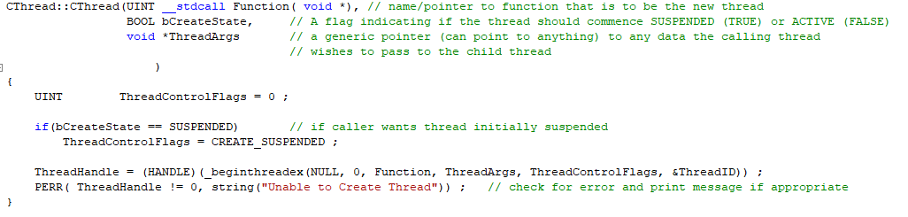
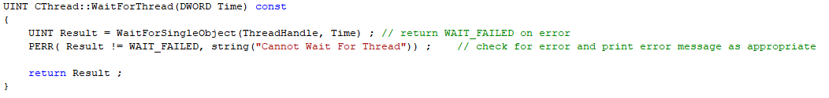
How does this work? The Windows OS call _beginthreadex()
The CThread constructor makes the actual call to the Windows Kernel. The threads “handle” is saved to identify the child thread later (e.g. when waiting for it to terminate)
The WaitForThread() function calls the windows kernel function WaitForSingleObject(), using the handle of the thread created above and a specified time to wait.

Slide 18
Thread Local Storage
Thread aware compilers allow multiple copies of a variable to be created for each thread.
In Visual C++ this is achieved by prefixing variables with the key word __declspec(thread).
In the RT library, this has been #defined as PerThreadStorage
#define PerThreadStorage __declspec(thread)
The example below demonstrates the concept.
PerThreadStorage int MyThreadNumber ;
UINT __stdcall ChildThread (void *args) // thread function
{
MyThreadNumber = *(int *)(args);
for ( int i = 0; i < 100; i ++) {
cout << "I am the Child number [" << MyThreadNumber << "] \n" ;
Sleep(200) ;
}
return 0 ;
}
Separate instance of this variable is created for each thread we create in this program
Read more here: https://docs.microsoft.com/en-us/cpp/parallel/thread-local-storage-tls?view=vs-2019

Slide 19
Quick sort: An Example Problem that maps well to multi-threading
You learnt about the quick sort algorithm in CPSC 259.
It is an algorithm for sorting data in an array, based upon a divide and conquer algorithm and it’s solution is expressed in a single threaded manner using recursion (i.e. a function calling itself, see pseudo code below).
    Select a `pivot' value from the array (usually the value of the middle element)
    Partition the array into two smaller left and right arrays, such that
    All elements in the left array have a value less than or equal to the pivot value
    All elements in the right array have a value greater than or equal to the pivot value
    QuickSort ( Left Array, NumberElementsLeftArray )
    QuickSort ( Right Array, NumberElementsRightArray )
Function: QuickSort (TheArray, NumElements)

Slide 20
However, if we had a multi-core computer, we might see an improvement in speed if we re-wrote it, based on a fine grained thread implementation rather than recursion.
    Select a `pivot' value from the array (usually the value of the middle element)
    Partition the array into two smaller left and right arrays, such that
    All elements in the left array have a value less than or equal to the pivot value
    All elements in the right array have a value greater than or equal to the pivot value
    Create instance of Quicksort thread to Sort Left Array
    Create instance of Quicksort thread to Sort Right Array
    Wait for both threads
Homework Problem: Discuss this algorithm in terms of it’s efficiency and speculate under what circumstances you would or would not see significant improvements in its execution speed in practice – Some factors to consider include the effects of hardware platform (e.g. number of CPUs/cores), the size of data being sorted and the time of an OS to create and swap between threads.
Thread: QuickSort (TheArray, NumElements)
Create 2 threads to sort left and right arrays in parallel

Slide 21
Concurrent Programming in an Object Oriented World: Active Objects
In languages like Java we can create multiple threads within our programs through the elegant use of ‘active objects’, i.e. objects with their own function run() that have their own thread of execution running through them. In fact all Java programs are instances of active classes since the program’s main() is inside the application class.
  class Simple{
  public static void main(String args[]) {
  System.out.println("Hello Java");
  }
  }
In a very real sense, an active object is like a complete mini application with a main(), all its own functions and variables. An active object thus has a “brain” and can think for itself.
Imagine if the CBulb class from lab 1 were an active object. It could decide for itself to turn on or off. Contrast this to a passive CBulb (one with no main()) which would only respond when code outside the object invoked one of its on() or off() functions.
Active Objects in the RT Library
In Visual C++ (using the RT library and Windows Kernel) we can create new active classes by deriving classes from the base class ActiveClass as shown on next slide.
(See also Q2A and Q2B tutorials in the RTExamples folder for a demonstration)
Java program with a main() inside a class. This makes it an active class. When you run the program, an instance of the class “simple” is created and the OS generates a thread to run the classes main()

Slide 22
Active Classes in the RT Library
Here we override the function main() inherited from the base class 'ActiveClass' and write it to do whatever we want our class object to do. We then create instances of the class to create active objects with their own thread.
These threads are controlled via the member functions of the CThread class as shown previously. Note that such threads are created in a suspended state so they MUST be resumed later with a call to the Resume() function.
class MyActiveClass : public ActiveClass {
…
private:
// Must override function main() inherited from ActiveClass. The base
// class constructor then creates a thread running through the function main()
int main (void)
{
for (int i = 0 ; i < 1000 ; i ++)
printf ( "Say Hello to my Active Class.....\n" ) ;
return 0 ;
}
} ;
A Class derived from ActiveClass
Active classes must override their base class main()
All Active classes must override b
Derived class main thread. Note ‘.h’ and ‘.cpp’ files have been combined to illustrate concept

Slide 23
class MyActiveClass1 : public ActiveClass {
private:
int main( void ) { // a thread within my class
for (int i = 0; i < 1000; i ++)
cout << "Say Hello to My Active Class 1.....\n";
return 0 ;
}
} ;
class MyActiveClass2 : public ActiveClass {
private:
int main( void ) { // a thread within my class
for (int i = 0; i < 1000; i ++)
cout << "Say Hello to My Active Class 2.....\n";
return 0 ;
}
} ;
int main(void)
{
MyActiveClass1 object1, object2, object3 ; // create 3 instances of the MyActiveClass1
MyActiveClass2 object4, object5, object6 ; // create 3 instances of the MyActiveClass2
object1.Resume() ; // allow thread to run as it is initially suspended
object2.Resume() ; // allow thread to run as it is initially suspended
…..
object1.WaitForThread() ;
object2.WaitForThread() ;
…..
return 0 ;
}
Combined class .cpp and .h file
Active Class objects have a brain and a thread running inside their main()
Combined class .cpp and .h file
Active Class objects have a brain and a thread running inside their main()
(See Q2A - RTExamples folder for Example)

Slide 24
Active Object Communication via message passing
MyActiveClass1
MyActiveClass1
MyActiveClass1
func1() { ….. }
func2() { ….. }
func3() { ….. }
int main()
{
}
func1() { ….. }
func2() { ….. }
func3() { ….. }
int main()
{
}
func1() { ….. }
func2() { ….. }
func3() { ….. }
int main()
{
Object5.func3() ;
}
Application
int main()
{
Create objects()
}
Object 1
Object 2
Object 3
MyActiveClass2
MyActiveClass2
MyActiveClass2
func1() { ….. }
func2() { ….. }
func3() { ….. }
int main()
{
}
func1() { ….. }
func2() { ….. }
func3() { ….. }
int main()
{
Object6.func1() ;
}
func1() {
Object2.func3();
}
func2() { ….. }
func3() { ….. }
int main()
{
}
Application main() acts like an object factory, generating new objects as required
Active objects can send messages to each other by invoking the target objects member function and thus communicate.
Note multi-threading within objects needs careful handling. Think about what would happen if two threads tried to run the same function in another object at the same time?
Object 4
Object 5
Object 6

Slide 25
Advanced RT Library Example: Multiple Threads within one Active Class
class MyClassName : public ActiveClass {
// constructors, member functions and data etc. go here. Note data is sharable (with caution) amongst all class threads.
int PrintMessageThread ( void *ThreadArgs ) {
for(int i = 0; i < 10000; i++)
cout << (char *)(ThreadArgs) << “\n”;
}
int DisplayClassData ( void *ThreadArgs ) {
. . .
}
int main(void) {
ClassThread <MyClassName> Thread1 ( this , &MyClassName::PrintMessageThread, ACTIVE, "Mess 1") ;
ClassThread <MyClassName> Thread2 ( this , &MyClassName::DisplayClassData, ACTIVE, NULL) ;
// wait for the above two child threads of the class to terminate
Thread1.WaitForThread() ;
Thread2.WaitForThread() ;
return 0 ;
}
} ;
int main()
{
MyClassName Object1 ; // create the active object in suspended state
Object1.Resume() ; // let object run it’s main(), which then creates 2 other threads
Object1.WaitForThread() ;
}
Active Class objects are like a mini program with a main() and multiple threads
Run
Child Thread of main Class Thread
Run
Child Thread of main Class Thread
String Argument passed to thread
No thread data
‘this’ is a pointer to the object itself so thread can access the variables in the object
Run State of the thread
Address of this class’s member function that will become the thread
Main Class Thread
Run
(See Q2B - RTExamples folder for Demo)
Process main Thread

Slide 26
Supplemental Notes
Creating Threads
with C++ 11 and POSIX Libraries.

Slide 27
Creating Threads with C++ 11 for Windows (feel free to try this)
New header file <thread> must be included
Signature of thread function accepts any number and type of parameters
To control thread, we still need to call the Windows Kernel
#include <iostream>
#include <thread>
using namespace std;
int ChildThread( int x ) // A thread function taking, in this example a single ‘int’ parameter
{
for (int i = 0; i < 100; i++)
cout << "Child thread [" << x << "] \n";
return 0;
}
Compiled code still makes calls to the Windows Kernel, so how do you think the compiler translates the multiple thread parameters, given that windows thread creation function requires one “void pointer”?
Include “thread” header file

Slide 28
int main()
{
thread *Threads[8]; // an array of 8 thread pointers
for (int i = 0; i < 8; i++) {
cout << "Parent Thread: Creating Child Thread " << i << " in Active State\n";
Threads[i] = new thread(ChildThread, i ); // create active thread objects
}
// wait for threads to terminate, then delete thread objects we created above
for ( int j = 0; j < 8; j++) {
Threads[j]->join(); // wait for each thread to die
delete Threads[j]; // delete the object created by ‘new’
}
return 0;
}
An array of 8 thread Pointers
Params can be passed by value
Params can be passed by value
Create 8 new Child thread objects based on above Fn
(See Q2_C++_11 in RTExamples folder for Demo)
Summary: Use thread instead of CThread, join() instead of WaitForThread(). More flexibility w.r.t. to passing arguments to the thread, but biggest drawback is no C++ standardisation related to controlling the thread, e.g. suspend, resume, kill etc. See here https://en.cppreference.com/w/cpp/thread/thread. To do that you have to get the thread id/handle and then call the kernel directly if required ☹

Slide 29
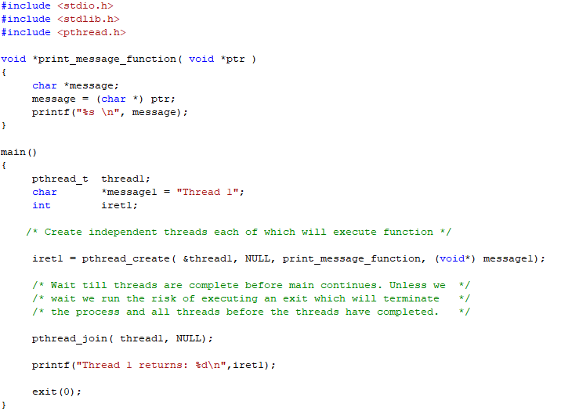
Creating threads with UNIX/Linux POSIX Library
New threads are created using pthread_create() and we wait for them to terminate using pthread_join(). Technique is used in OSX and Android.
Click here for a tutorial on POSIX threads
Child Thread
Similar to native windows call

